Slide 1
DOAS
Flexible Benefits Premium Tool
A new way forward
February 2023
Training for Manual/Hybrid Entities

Slide 2
Agenda
Overview of the new tool
What is changing and why?
  Deep dive of the new online tool: Flexible Benefits Premium
Live demonstration
Your role
Timeline and support
Questions and discussion
Wrap-up and next steps
Notes:
Welcome to today’s session.
Here is an overview of what we’re planning to cover while we’re together.
[Presenter to review each item on the agenda.]
So, please participate and fully engage with this session: Ask questions, provide feedback, and most importantly commit to using the new tool to help us forge a new way forward.

Slide 3
DOAS Flexible Benefits Premium Tool
A new way forward … Empowering you to use the new tool for reviewing and submitting Flexible Benefits Plan premium payments.
Payroll Representative
Chief Financial Officer
Accounts Payable Fiscal Representative
Supports all roles involved in monthly invoice processing and payment.
Benefits Coordinator
HR Director
Notes:
During this session, our goal is to equip and empower you to start using the new payment tool for reviewing and submitting Flexible Benefits Plan premium payments.
Notice the tag line – “A new way forward.” We selected it because this new tool is designed to simplify your workload and make the payment process faster and easier.
This training is designed to support all roles involved in monthly invoice processing and payment, including:
HR Director
Benefits Coordinator
Payroll Representative
Accounts Payable Fiscal Representative, and
Chief Financial Officer

Slide 4
Change Management Strategy
  Track results and measure
  effectiveness
  Assess stakeholder needs
6
1
  Provide ongoing support—meeting stakeholders where they are
  Align and inform leaders—engage them as advocates
5
2
  Build capability
  Align expectations
  Develop support
  skills
  Communicate
  Reinforce the benefits and impact of the tool
  Demonstrate
  empathy
4
3
Notes:
The change management strategy we developed to help you adopt the new Flexible Benefit Premium tool has six phases:
We started by assessing the needs of our participating entities, who will be the primary stakeholders in this effort.
We also focused on aligning and informing key leaders so they are comfortable serving as advocates for the new tool.
The third and fourth phases of our change management strategy are closely related.
Phase 3 centers around our commitment to communicating clearly – so entities can learn the benefits and expected impact of the new tool. At the same time, we want to demonstrate empathy. Change can be hard, even when it is for the better.
Phase 4 focuses on building capability by helping impacted entities get comfortable using the new tool, making sure they understand what is expected and helping them develop the necessary skills. Today’s training is a key component of Phase 4.
Effective change management also requires that we provide impacted entities with ongoing support – by meeting them where they are in the learning/adoption process.
The final component of our change management strategy is to track results and measure the effectiveness of our efforts.

Slide 5
What Is Changing and Why?
Notes:
For the next few minutes, we will quickly recap what’s changing and why.

Slide 6
Current Process
Dental Insurance
Vision Insurance
Life and AD&D Insurance
STD and LTD
Critical Illness Insurance
Long-term Care Insurance
Legal Plans
Health Care and Dependent Care FSAs
Participating state and local entities send Flexible Benefit premiums to DOAS Finance
each month.
DOAS Finance uses these premiums to pay the Flexible Benefit vendors’ premiums due based on reports from
Alight Solutions, the GaBreeze Benefits System administrator.
Question to discuss:
Which roles are involved in the current monthly payment premium process for your entity?
Notes:
As you know, the Georgia Department of Administrative Services (DOAS), Human Resources Administration (HRA) division is dedicated to providing HR and talent management solutions that empower state entity HR and business leaders to manage their workforce in an effective and efficient manner.
One of the most critical services we provide is the administration of the State of Georgia Flexible Benefits Program, including:
Dental Insurance,
Vision Insurance,
Life and AD&D Insurance,
STD and LTD (Short-Term Disability and Long-Term Disability),
Critical Illness Insurance,
Long Term Care Insurance,
Legal Plans, and
Flexible Spending Accounts for Health Care and Dependent Care.
The visual on the left of the slide illustrates how the monthly process works now.
As you can see, participating state entities send Flexible Benefit premiums to DOAS Finance each month.​
DOAS Finance uses these premiums to pay the Flexible Benefit vendors’ premiums due based on reports from Alight Solutions, the GaBreeze Benefits System administrator. ​
Because this process is complex and time-consuming, DOAS and Alight have partnered to improve the process through a more streamlined and efficient online tool.
[Facilitator: Take time to discuss the following question before moving to the next slide.]
Before we discuss how this process will be changing, we would like to spend a few minutes discussing the roles that are involved in the current monthly premium process for your entity. What key roles handle this process for your Entity? What are their responsibilities?

Slide 7
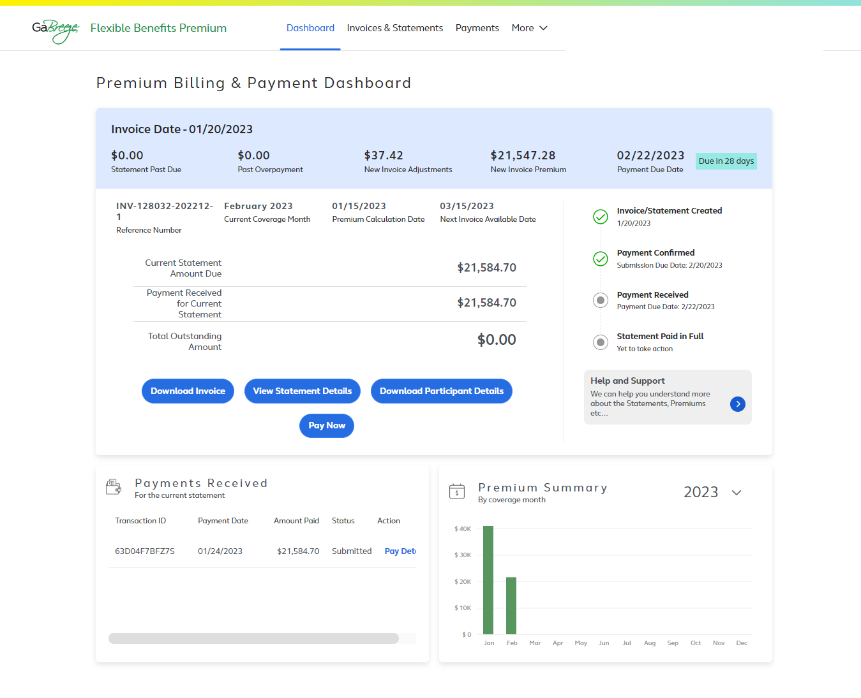
New online tool + payments to Alight
Simplifies payment processing and collection of Flexible Benefit Premiums
  Monthly payments will made to Alight, not DOAS
Provides:
  Clear, concise invoicing data for monthly premium payments
  Reporting that supports timely and accurate payment processing
  An easy, at-a-glance dashboard view of the payment process
The new tool will be rolled out to all participating entities this year.
Notes:
To address these challenges and simplify your work effort, we have partnered with the GaBreeze Benefits System administrator, Alight Solutions, to develop a new online tool that will replace this process.
This tool will provide us with a system that provides clear, concise invoicing data for premium payments, as well as reporting that supports timely and accurate payment processing.
It was developed specifically for DOAS and you, our participating entities.
More importantly, it is designed to simplify payment processing and collection – providing you with easy, online access to clear and concise statements, invoices and reports.
And here’s the best news: The new tool is rolling out to all participating entities now, you can start using the tool for upcoming invoices.

Slide 8
New Online Flexible Benefits Premium Tool
Notes:
In this section, we will take a closer look at the new tool.
We will start by reviewing the key features using screen shots and then do a live demo.

Slide 9
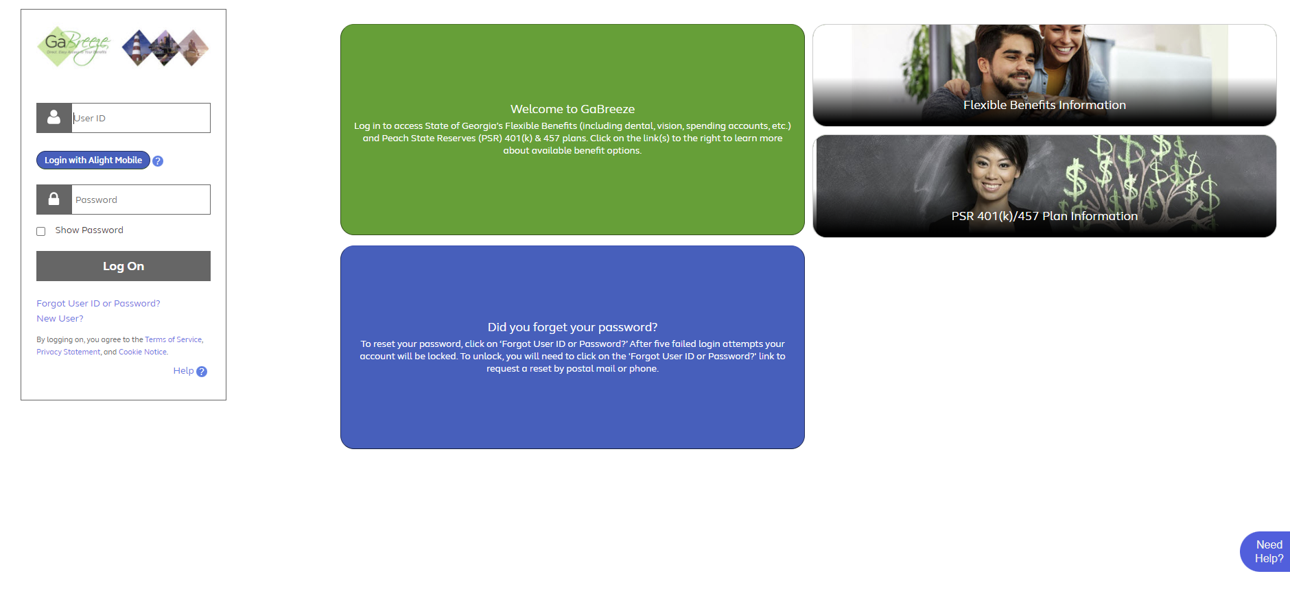
Accessing the Flexible Benefits Premium Tool
Log on to www.GaBreeze.ga.gov to access the new tool with the same credentials used to access your personal accounts.
Notes:
Going forward, you will use the Flexible Benefits Premium tool to view your remaining outstanding premium amount and to make applicable payments.
All users will access the new online tool through the UPoint GaBreeze site at www.GaBreeze.ga.gov (under the Administrative Tools section).
You will need your User ID and password to authenticate into the site.
If you do not remember your credentials, select the Forgot User ID or Password link under the Log On button. Then follow the prompts to reset your credentials. If you need to reset your credentials if you have a cell phone number online, you can receive a one-time code to update your password. Otherwise, your password will be sent you via the US Postal Service.
If you are new to the site, select the New User link, also under the Log On button, and then follow the prompts to set up your credentials.
Finally, please note that the User ID and password are the identification credentials used to access their personal accounts and not the User ID used to access the normal GaBreeze Employer Portal.

Slide 10
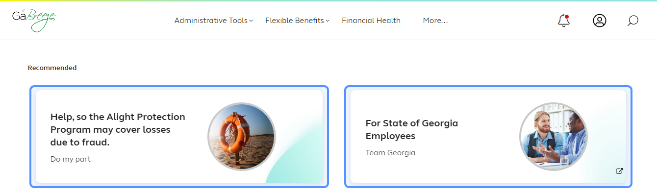
Accessing the Flexible Benefits Premium Tool
Select Administrative Tools
Notes:
Once you are logged into the GaBreeze site you can access the Flexible Benefits Premium tool via the top drop-down menu.
Entity users who have been granted access to the tool will see an Administrative Tools drop down on the far left at top of the page.
Selecting this drop-down will route the entity user to a page which will link out directly to the Flexible Benefits Premium tool.

Slide 11
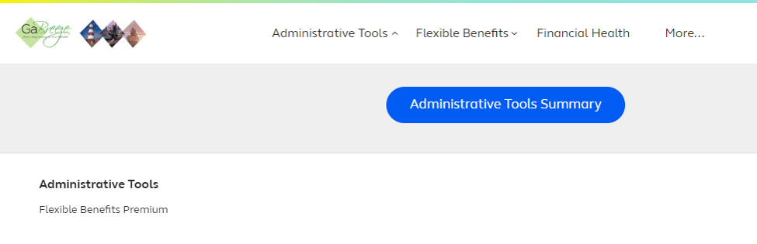
Accessing the Flexible Benefits Premium Tool
Select Flexible Benefits Premium
Or click the Administrative Tools Summary button.
Notes:
After you select the Administrative Tools drop-down, you will see this page. The words Flexible Benefits Premium are a direct link out to the tool.
In addition, a new Administrative Tools Summary button appears. This is where Alight will be storing access to multiple tools, including the Flexible Benefits Premium.
Clicking on this button will take you to the Tools Summary page.

Slide 12
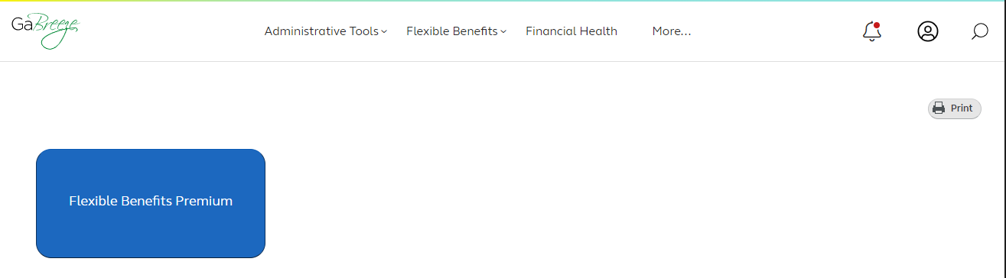
Accessing the Flexible Benefits Premium Tool
Access the Flexible Benefits Premium tool from the Administrative Tools Summary page
Notes:
The Flexible Benefits Premium tile can also be clicked on this page and will route the entity user directly into the Flexible Benefits Premium tool.

Slide 13
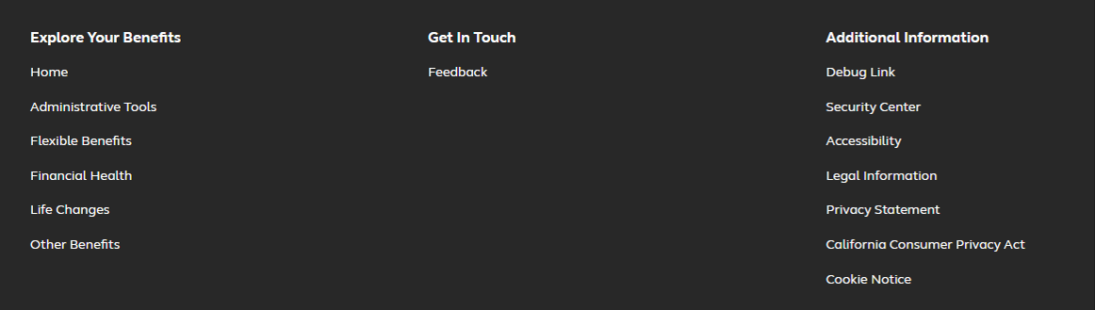
Accessing the Flexible Benefits Premium Tool
The Footer appears at the bottom of all GaBreeze pages.
It also contains a link to Administrative Tools.
Notes:
GaBreeze web site pages also include Footers at the bottom of each page. The footer contains a link to the Administrative Tools as well.

Slide 14
Flexible Benefits Premium Dashboard
The dashboard provides a quick view of the amount due, current, payment received, and the total outstanding amount.
Convenient navigation to download invoices, view statement details, download participant details, and make payments.
View your most recent payment.
Notes:
This dashboard is the first screen you will see after you access the new tool.
It provides an easy, at-a-glance view of the payment process.
The light blue bar at the top shows the invoice date as well what makes up the current amount due, specifically:
The new invoice premium,
The new invoice adjustments, and
Any past due amounts.
This section of the dashboard also shows the invoice/statement date and the payment due date.
The section under the blue bar shows the current statement amount due, the payment received for the current statement, and the total outstanding amount.
You can use the dark blue buttons to download the invoice, view statement details, download participant details, or pay.
The Payments Received section allows you to view your most recent payment.

Slide 15
Flexible Benefits Premium Dashboard (cont.)
Keep track of the steps in the payment process.
Get help and support.
View a summary of premiums by coverage month. Hover over the third bar to see graphic legend.
Notes:
On the right side of the dashboard, you will see a tracker that helps you keep track of where you are at in the payment process.
You will also find a help and support button that connects you to additional resources.
The bottom section of the dashboard allows you to view payments received as well as a premium summary. Hover over the third bar to see the graphic legend.

Slide 16
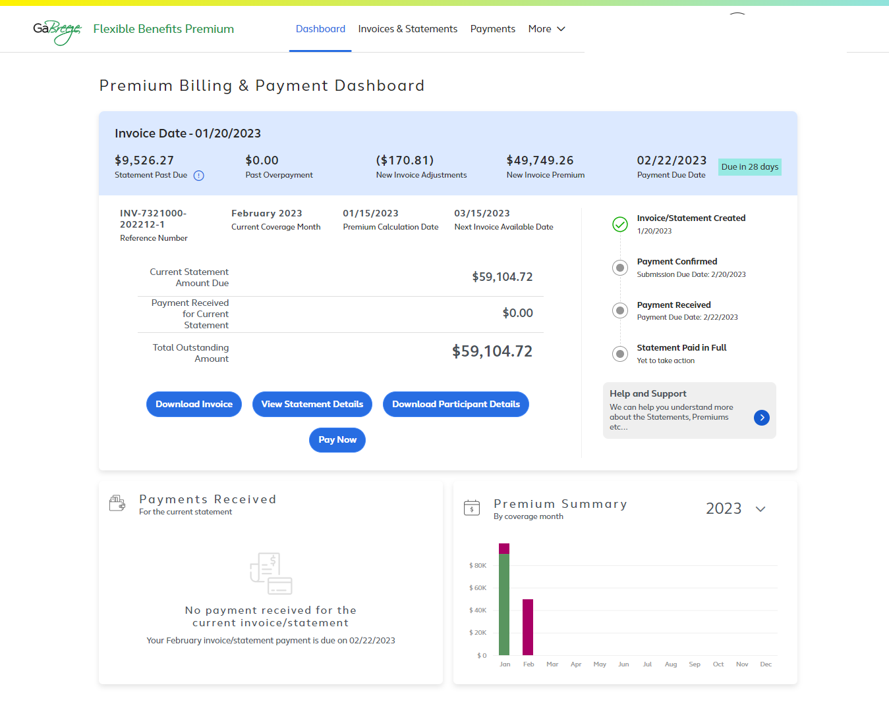
Flexible Benefits Premium Dashboard (cont.)
Past due amounts display here.
Notes:
The tool allows you to easily view past due amounts from the Invoice Date section at the top of the page.

Slide 17
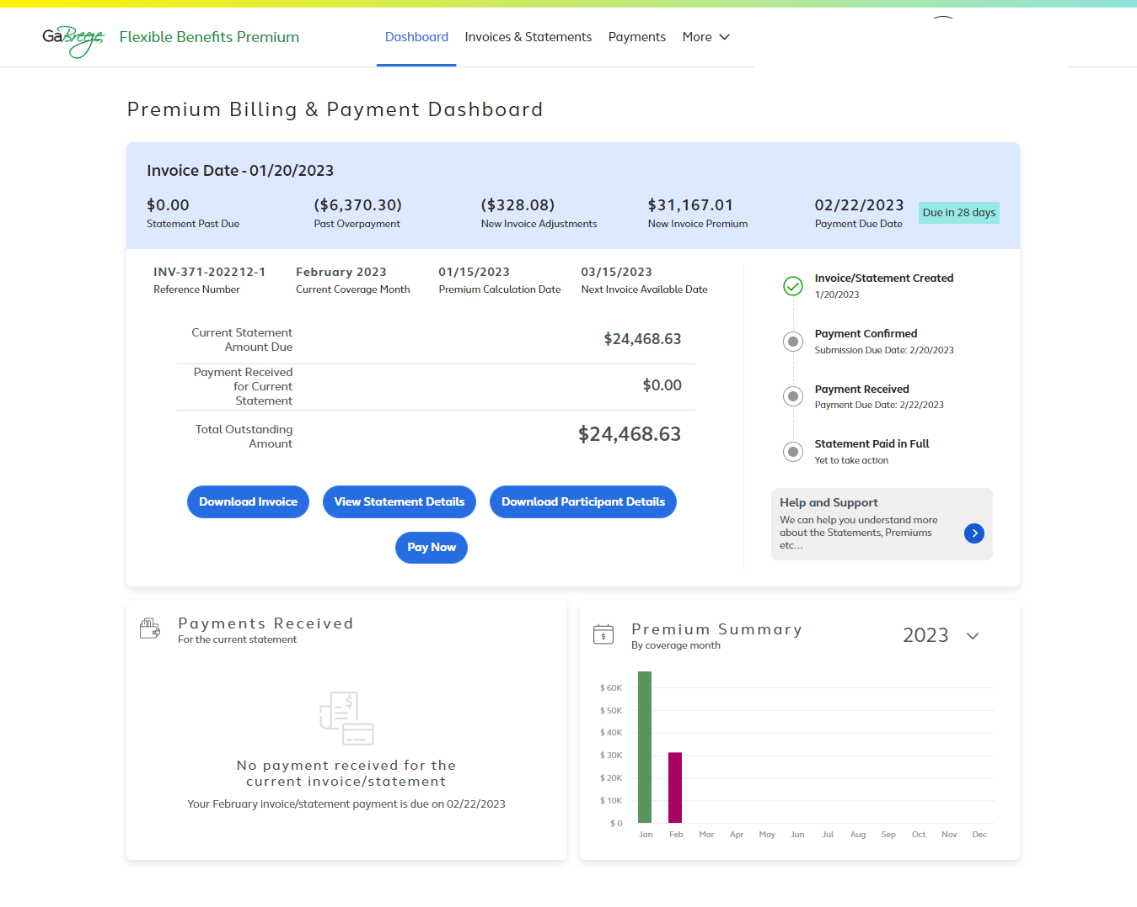
Flexible Benefits Premium Dashboard (cont.)
Overpayments for the prior month display here.
Notes:
The Invoice Date section also shows any overpayments for the prior month.

Slide 18
Dashboard: Four Navigation Buttons Guide You to Key Processing Steps
Select these buttons to complete your monthly processing steps
Notes:
The four blue navigation buttons are another important feature of the dashboard.
These buttons are designed to guide you through the four key invoice processing steps each month:
Downloading the invoice
Viewing statement details
Downloading a file with participant details, and
Paying the invoice.

Slide 19
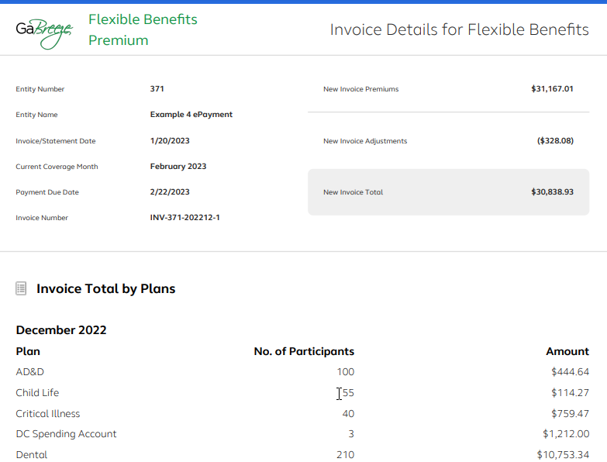
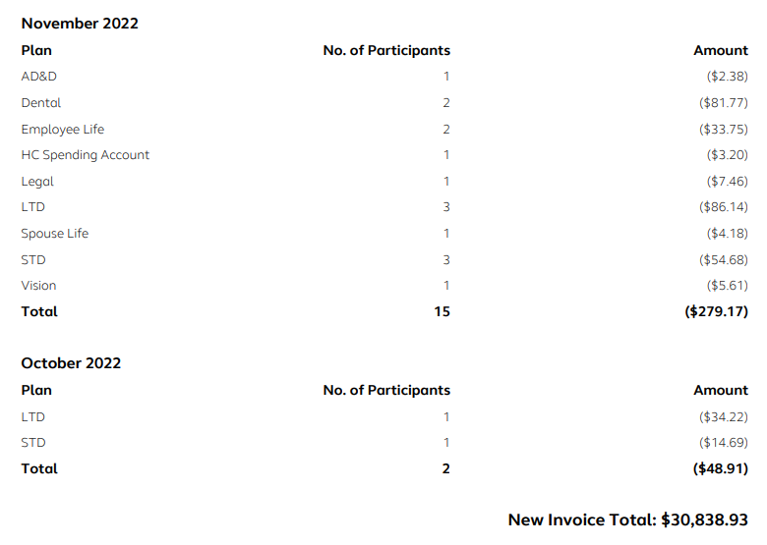
Dashboard: Download Invoice
Click Download Invoice to download, view, and/or print.
The invoice includes:
Covered plans
Number of participants
Amounts due
New invoice total
Please pay the amount in full.
Make any necessary eligibility and/or HR updates with your HR/Payroll team or in the Employer Website tool
(manual entities only).
Notes:
When you select the Download Invoice button from the dashboard, the tool will open your most recent invoice.
It is important to check the invoice to confirm the following information for each month:
Covered plans,
Number of participants, and
Amounts due.
The new invoice total is shown at the bottom of the invoice.
Please pay the amount in full.
If any eligibility and/or HR updates are needed, please make them with your HR/Payroll team. Note that manual entities will use the Employer Website tool.

Slide 20
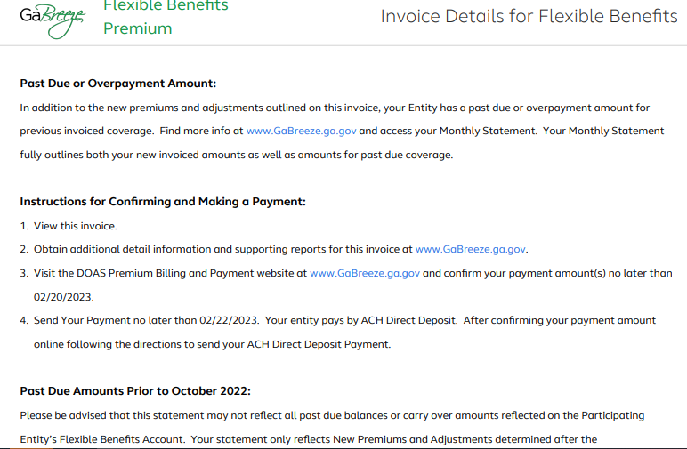
Dashboard: Download Invoice (cont.)
Follow the instructions for paying your invoice.
Notes:
Be sure to follow the instructions provided when you pay your invoice.
[Presenter should quickly review the instructions.]

Slide 21
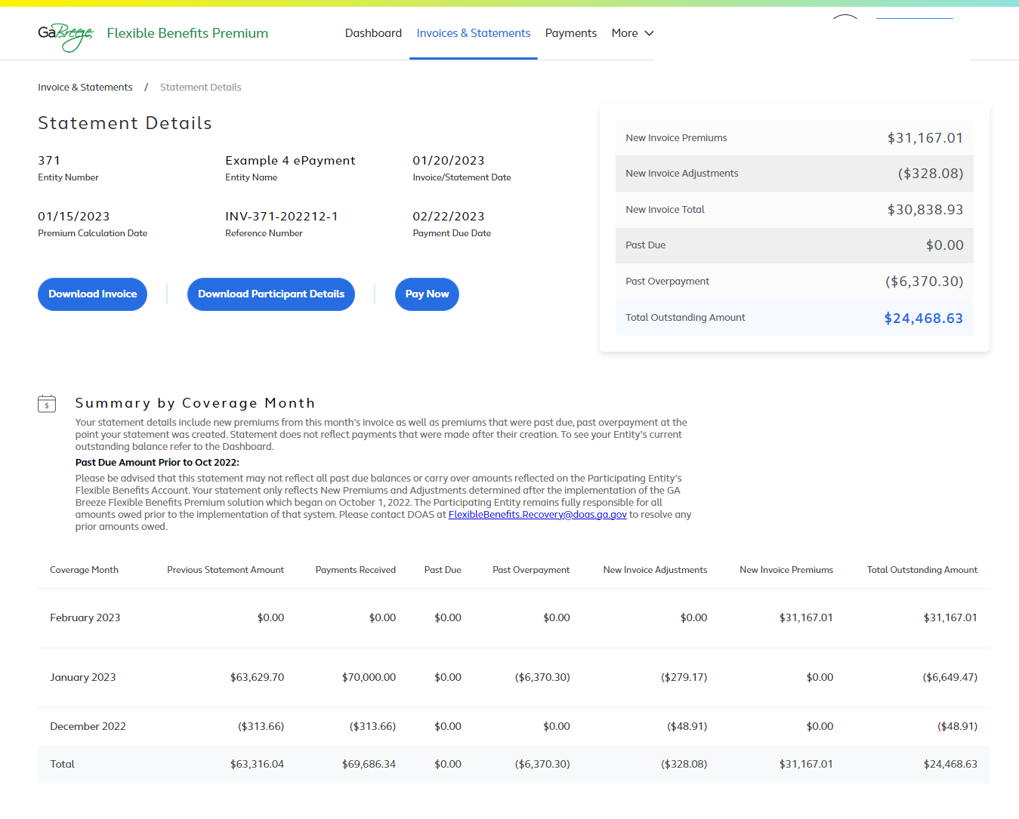
Dashboard: View Statement Details
Select the appropriate blue button to download your invoice, download participant details or pay.
View a summary of the total outstanding premiums.
View details about:
Previous statement amounts
Payments received
Past due amounts
New invoice premiums
New invoice adjustments
Total outstanding amount
Notes:
When you select the View Statement Details button, you will link to the Statement Details page that is shown here.
You can use the three blue navigation buttons to download your invoice, download a file with participant details or pay.
This page also provides a summary of the total outstanding premiums, as well as a Summary by Coverage Month section with details about:
Previous statement amounts,
Payments received,
Past due amounts,
New invoice premiums and new invoice adjustments, and
The total outstanding amount.

Slide 22
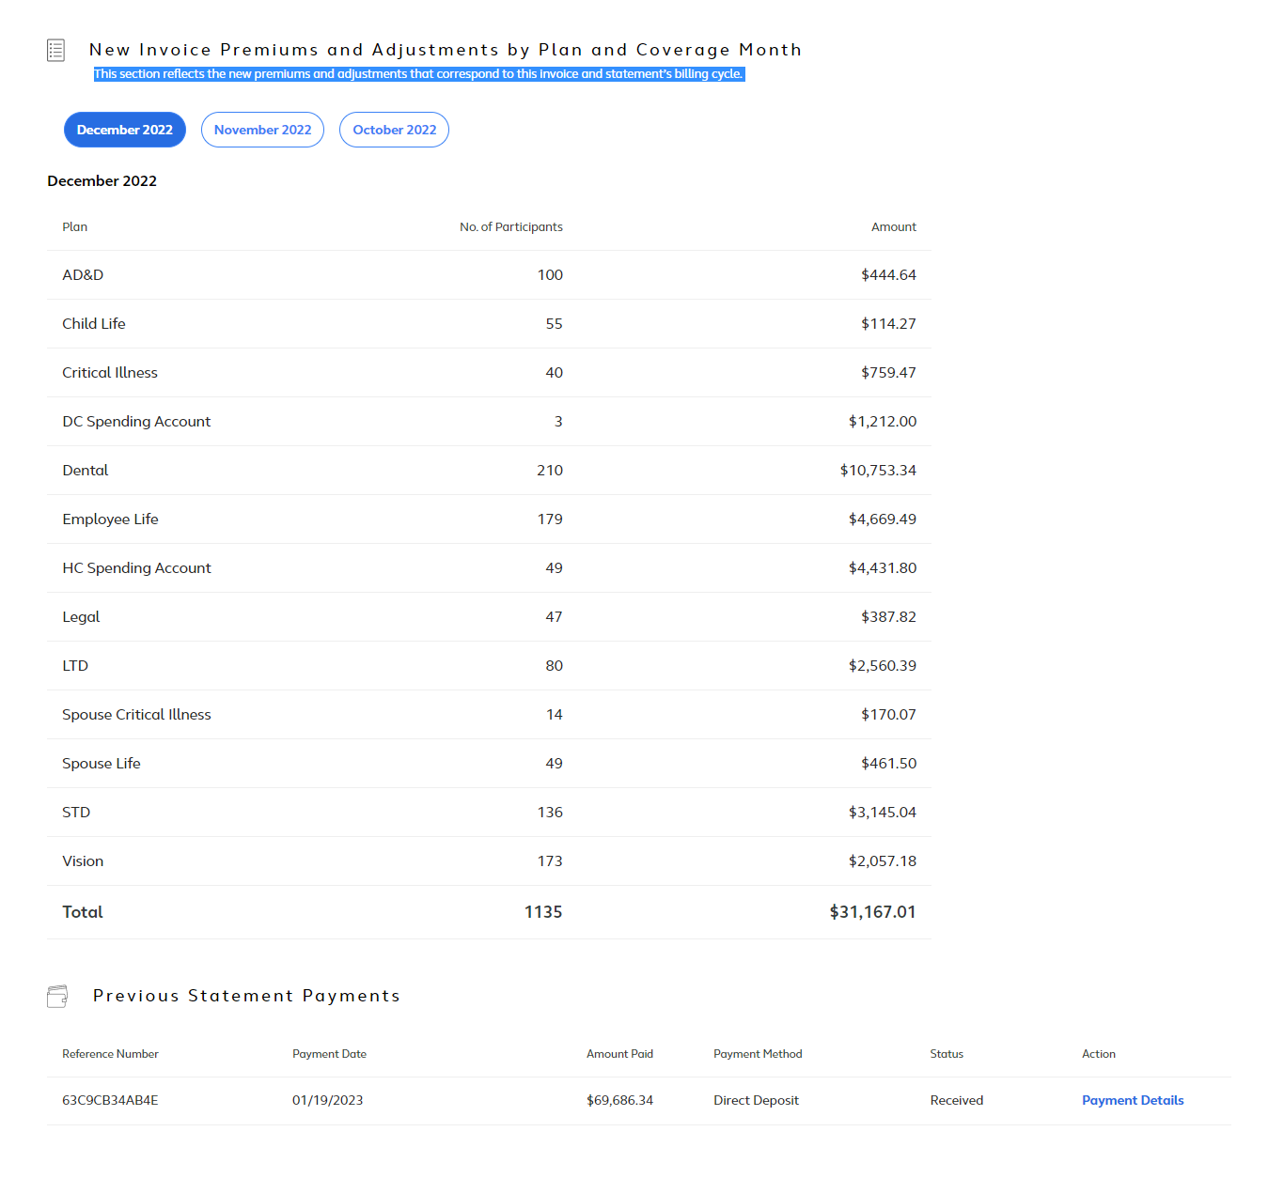
Dashboard: View Statement Details (cont.)
Use the blue buttons to choose the month you want to view.
Notes:
Here is a screen shot of the additional information you’ll see as you scroll through the statement screen.
Use the blue buttons to choose the month you want to view.

Slide 23
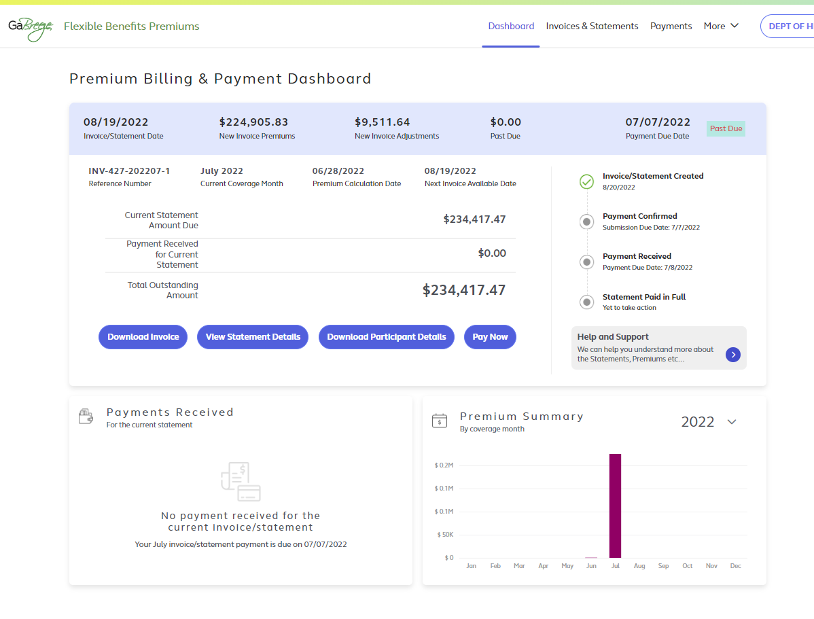
Dashboard: Download Participant Details
Select the Download Participant Details button to download a report in a CSV file with details of each participant's plan options, the premium amounts and administrative fees.
Notes:
After you select the Download participant details button, the tool will download a report in a CVS file with details of each participant’s plan options, the premium amounts and administrative fees.
Review this file to confirm the number of participants covered since that is what determines the premium amounts due.

Slide 24
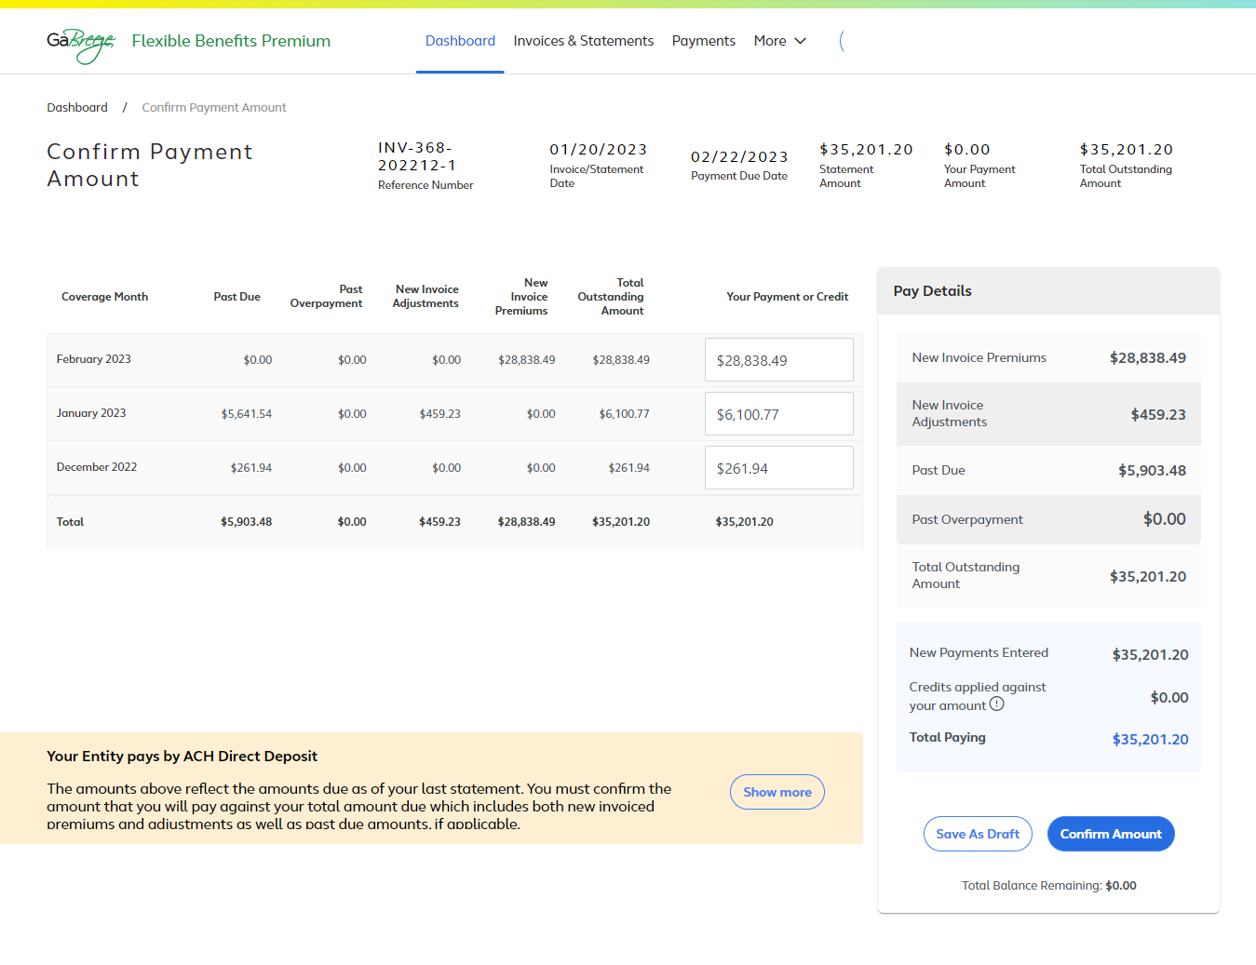
Dashboard: Pay Now Initial Screen
All Payment Methods (Prior Month Past Due)
Review the Pay Details.
Review details for each Coverage Month.
Past Due amount
Select Confirm Amount to authorize payment via ePayment, Direct Deposit or check. Select Save as Draft if you are not ready to confirm.
Important! Confirming the payment amount ensures that you have tracked the money you are paying against the premiums you are paying, so that what is paid corresponds to what is invoiced. However, this is NOT the last step!
Notes:
Here is the screen that appears when you select the Pay now button from the dashboard. This initial screen is the same whether your entity pays by ePayment, Direct Deposit or Check – with one exception that I’ll cover at the end.
Start by reviewing the details for each Coverage Month.
Coverage Months correspond to the actual coverage of your employees. However, Coverage Months premiums are not always calculated in the actual month of coverage. This is because retroactive enrollments (such as a birth of a child enrolled in coverage after birth) can adjust previous months coverage.
Therefore, in each invoice you will likely see nearly all of your premiums in the current Coverage Month, but you may also see adjustments to previous Coverage Months.
Adjustments can be both positive (additional money due) or negative (credits against other premiums due).
The next step is to review the pay details for the current amount due. [Presenter to highlight each item on the list.]
When you have completed that step, hit Confirm Amount to authorize your payment via ePayment, ACH or check (depending on your agency). This confirmation step ensures that you have tracked the money you are paying against the premiums you owe, so that what is paid corresponds to what is billed. However, please note that this is not the last step in the confirmation process. It simply takes you to the NEXT steps in the payment/confirmation process.
If you are not ready to confirm and pay, you can select Save as draft before you leave the page.
This screen is the same for all 3 payment methods I just mentioned. However, the next steps and screens differ by payment method. As a result, there is a different message at the bottom of this screen with specific information about next steps for each payment method.
Final note before we move on: This example shows a Past Due amount from the prior month of $4,903.48. This Past Due amount is ADDED to the Total Outstanding Amount on this screen.

Slide 25
Payment Methods
Participating entities need to choose their preferred payment method
within 1 week of this training session:
epayment
ACH Direct Deposit
Check
Note: ePas will no longer be available for entities currently using that payment method.
Notes:
Participating entities need to choose one of these forms of payment within 1 week of this training session:
epayment
Direct Deposit
Check
If your entity is currently using ePas, that payment method will no longer be offered. Your entity will need to choose one of the above payment methods.
We’ll cover the payment steps for each form of payment next.

Slide 26
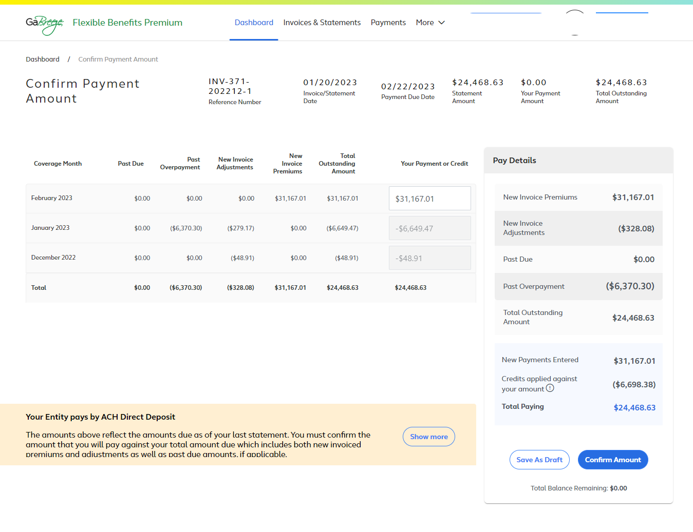
Dashboard: Pay Now Initial Screen
All Payment Methods (Overpayment)
Past Overpayment amount
This message varies based on your Entity’s payment method.
Notes:
This screen shot is identical to the one we just viewed with one exception:
Instead of showing a Past Due amount for the prior month, it shows a Past Overpayment amount.
As you can see, the Past Overpayment is SUBTRACTED from the Total Outstanding Amount.
Note: The message in the tan box at the bottom of the screen varies by payment method. This example shows the message for Entities that pay by ACH Direct Deposit. If your Entity uses a different payment method, you will see a different message.

Slide 27
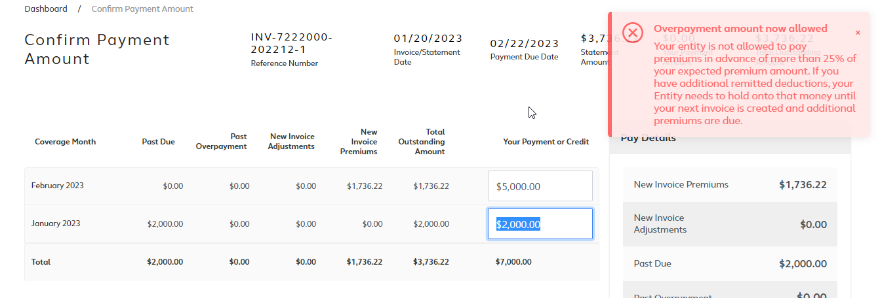
Dashboard: Overpayment rules
The tool has been enhanced to allow participating entities to pay more than the invoice amount. However, entities cannot pay premiums in advance of more than 25% of the expected premium amount.
Notes:
All entities can make overpayments if they so desire.
However, there is a limitation on how much they can overpay.
That limit is no more than 25% of total outstanding balance for the current cycle.
An entity that attempts to pay more than the limit will see the Overpayment Edit shown on this screen shot.

Slide 28
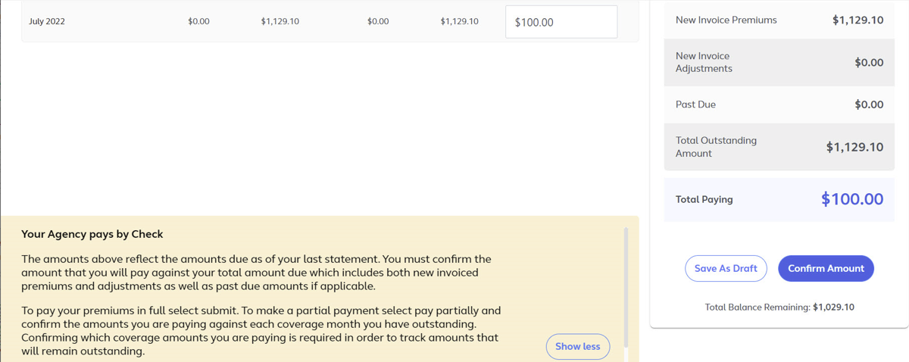
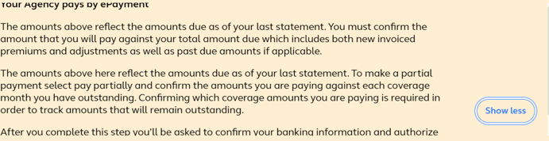
Dashboard: Pay Now Message: ePayment
If your entity pays by ePayment, you will see this message at the bottom of the Pay Now screen.
Notes:
If you are paying by ePayment, you will see this message at the bottom of the Pay Now Screen. Please review before you select Confirm Amount.

Slide 29
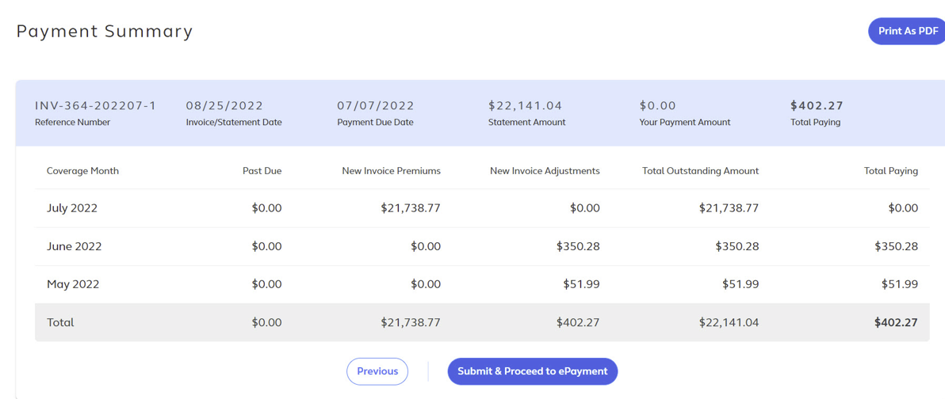
Dashboard: Pay Now Follow-up Screen 1: ePayment (cont.)
Pro Tip: You can print this summary as a PDF.
Review the Payment Summary screen and then select Submit & Proceed to ePayment.
Notes:
You will see this Payment Summary Screen after you select Pay Now.
Review the summary for each month and select Submit & Proceed to ePayment.
For entities that are paying via ePayment, the authorization to formally submit the payment will be limited to the AP Fiscal Representative and Chief Financial Officer at the entity.

Slide 30
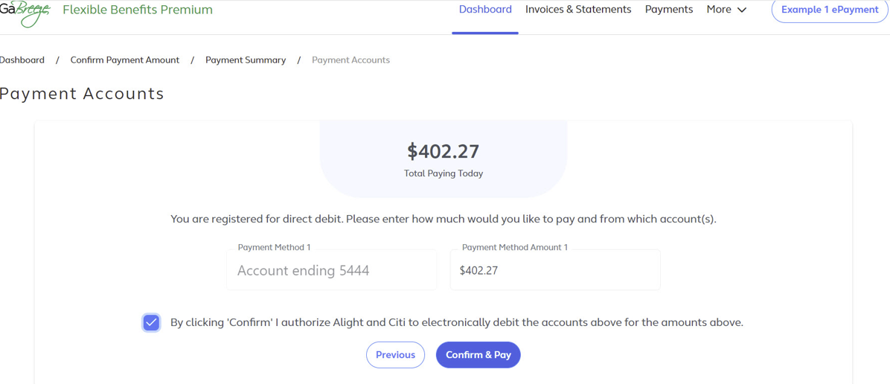
Dashboard: Pay Now Follow-up Screen 2: ePayment (cont.)
Enter the amount you want to pay and from which accounts.
Select Confirm & Pay to authorize the payment.
Notes:
Here is the screen that appears after Submit & Proceed to ePayment is selected.
The AP Fiscal Representative or Chief Financial Officer will need enter the amount they want to pay and indicate the bank account the payment should be taken from.
Their final step is to select Confirm & Pay to authorize payment.

Slide 31
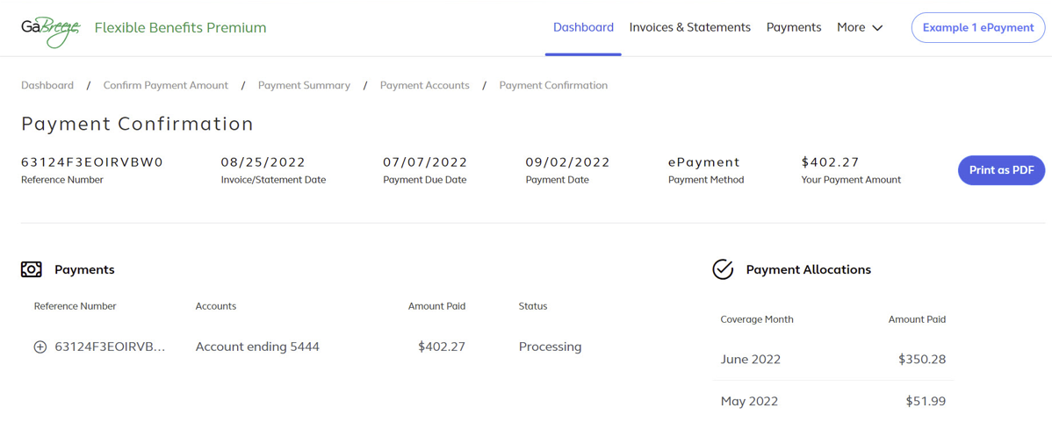
Dashboard: Pay Now Follow-up Screen 3: ePayment (cont.)
Review the Payment Confirmation information on this screen and select Print as a PDF to print a file for your records.
Notes:
This Payment Confirmation screen will appear after the ePayment is authorized.
The entity’s AP Fiscal Representative or Chief Financial Officer should review and then select Print as a PDF to obtain a copy for your entity’s records.

Slide 32
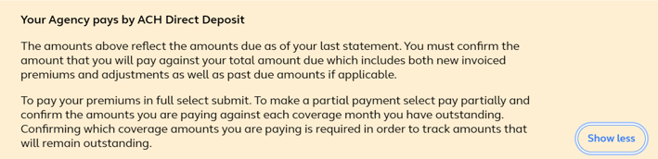
Dashboard: Pay Now Message:
Direct Deposit
If your entity pays by Direct Deposit, you will see this message at the bottom of the Pay Now screen.
Notes:
If you are paying by Direct Deposit, you will see this message at the bottom of the Pay Now Screen. Please review before you select Confirm Amount.

Slide 33
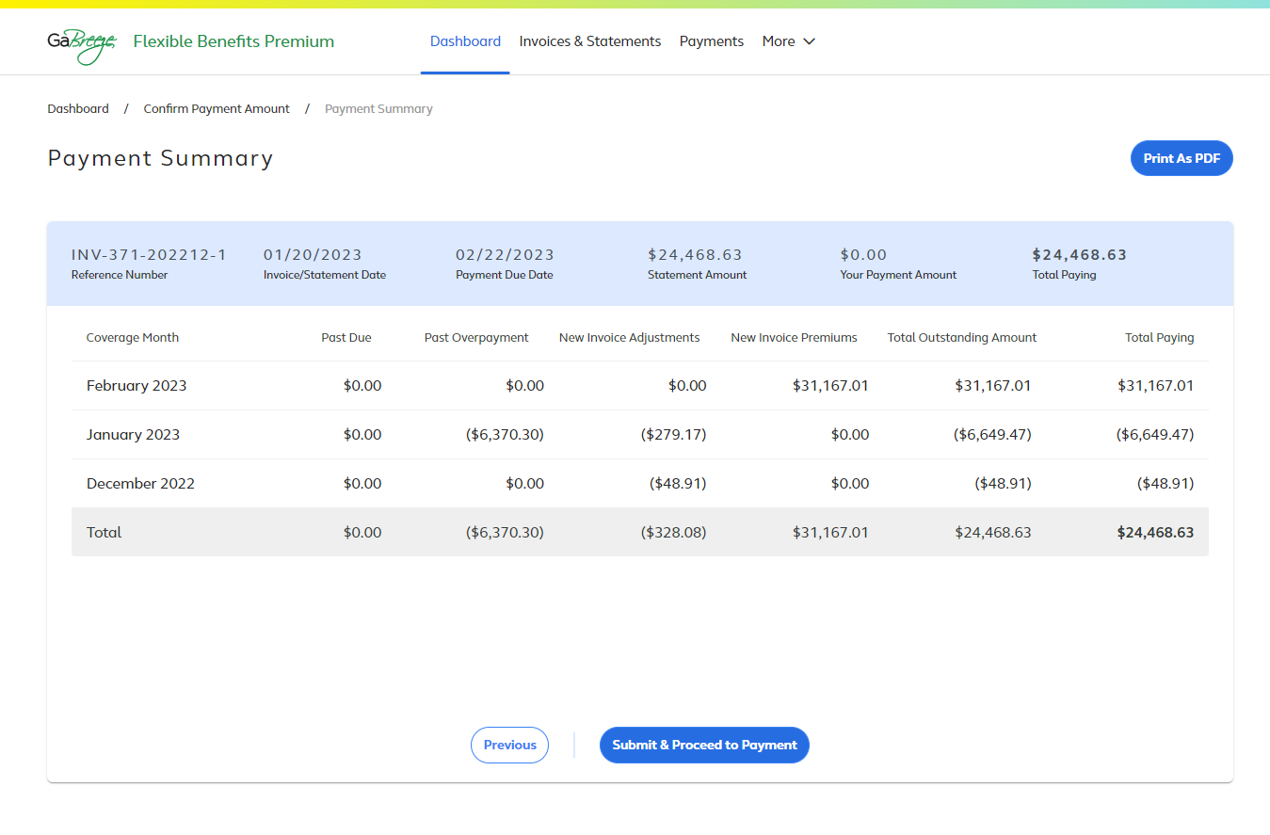
Dashboard: Pay Now Follow-up Screen 1:
Direct Deposit (cont.)
Review this Payment Summary Screen and select Submit & Proceed to Payment when you are ready to initiate payment.
Notes:
Here is the Payment Summary Screen that appears for entities that pay by Direct Deposit.
Review the summary and then select Submit & Proceed to Payment to begin the payment process.

Slide 34
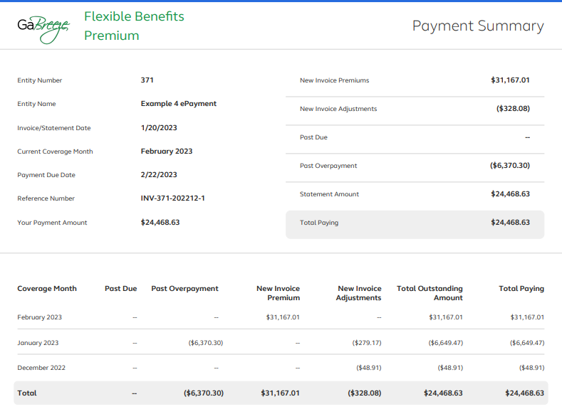
Dashboard: Pay Now Follow-up Screen 2:
Direct Deposit (cont.)
Review this follow-up screen for additional details about Past Due amounts, Past Overpayment amounts and the Total Outstanding Amount due.
Notes:
After you begin the payment process, you will see this screen, which contains details about any Past Due amounts, Past Overpayment amounts and your Total Outstanding Amount due.

Slide 35
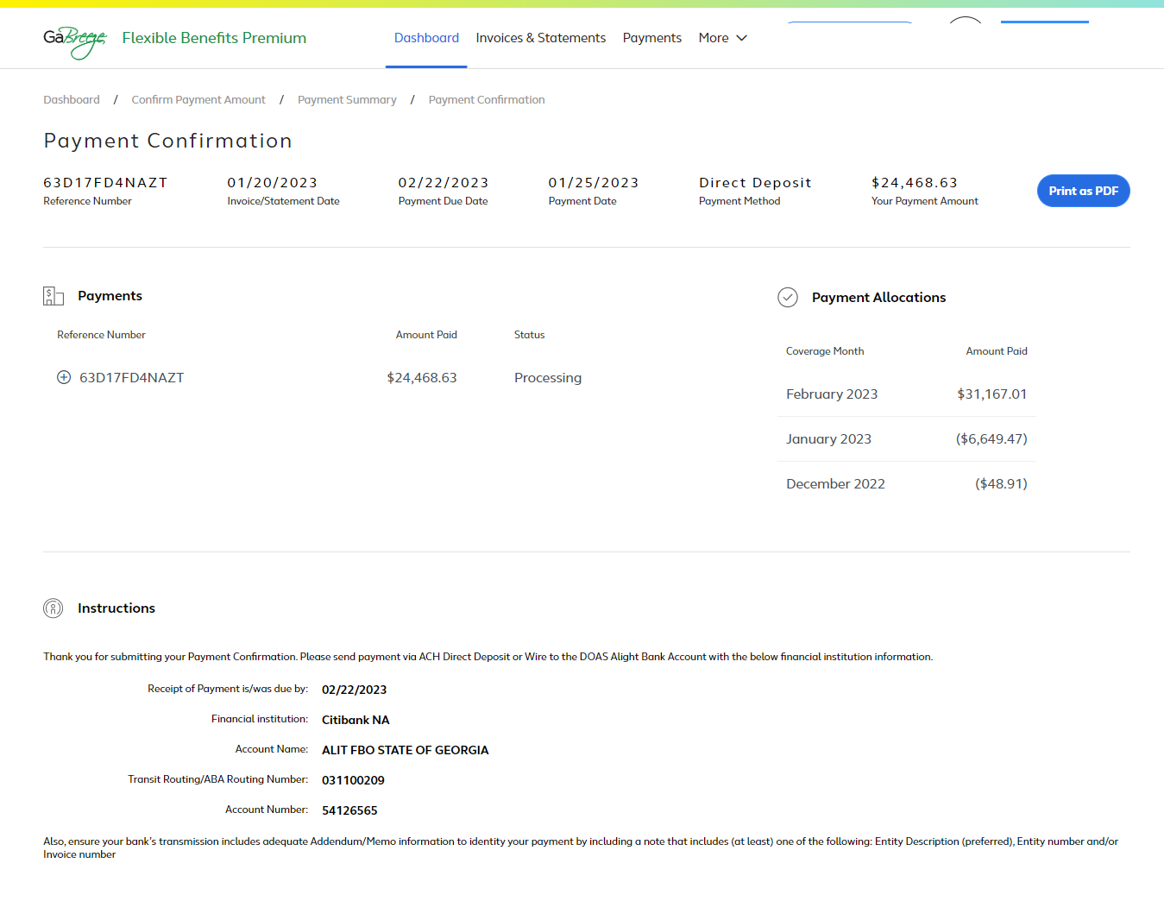
Dashboard: Pay Now Follow-up Screen 3:
Direct Deposit (cont.)
When you see the Payment Confirmation Screen, make sure the status is “Processing.”
Select “Print as a PDF” to obtain a copy of this page for your records
Notes:
After you begin the payment process, you will see this Payment Confirmation Screen.
Check to make sure the status is Processing.
Select Print as PDF to obtain a copy of this page for your records.

Slide 36
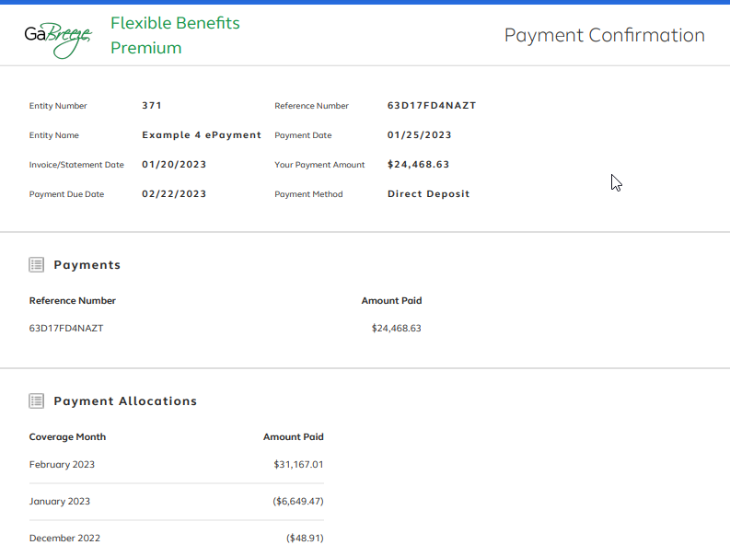
Dashboard: Pay Now Follow-up Screen 4:
Direct Deposit (cont.)
You will see this screen when your payment has been processed.
Notes:
This screen shows what you will see when your payment has processed.

Slide 37
Dashboard: Pay Now Message:
Check Payment
If your entity pays by check, you will see this message at the bottom of the Pay Now screen.
Notes:
If your entity pays by check, you will see this message at the bottom of your Pay Now screen.
Review this message before you select Confirm Amount.

Slide 38
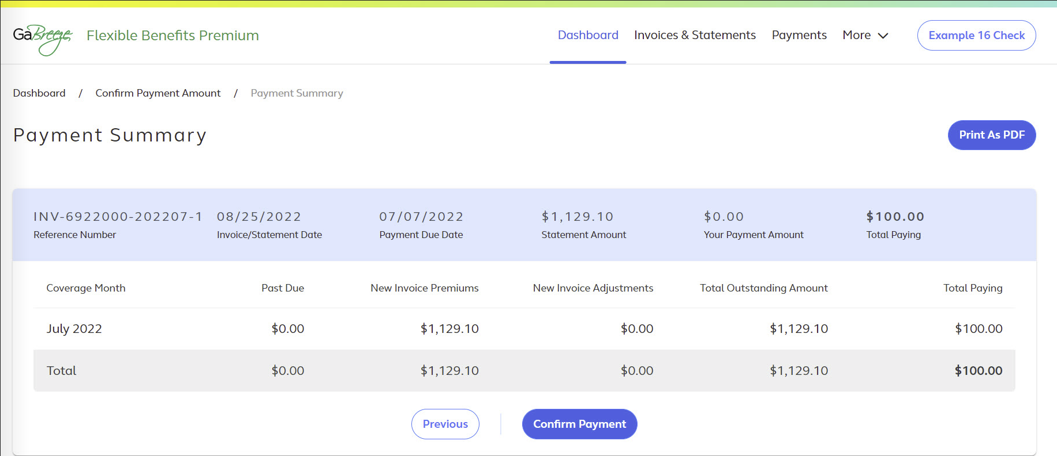
Dashboard: Pay Now Follow-up Screen 1:
Check Payment (cont.)
Select Print as PDF to download and print the Payment Statement that must be included with your check.
Choose Confirm Payment to
complete the online process.
Notes:
After you confirm your payment amount on the prior screen, you will see this Payment Summary screen. You need to complete two steps to process your payment:
First, select the Print as PDF button to download and print the payment statement that must be included with your check payment.
The statement has instructions on where and by when to mail the check. It also includes prepopulated information that facilitates the processing of the check at the Alight/Citi lockbox.
A manufactured number included on the statement is keyed along with the check.
Alight Solutions then uses this number to associate the check payment with the correct entity.
Second, after you have downloaded and printed the statement, select Confirm Payment to complete the online process.

Slide 39
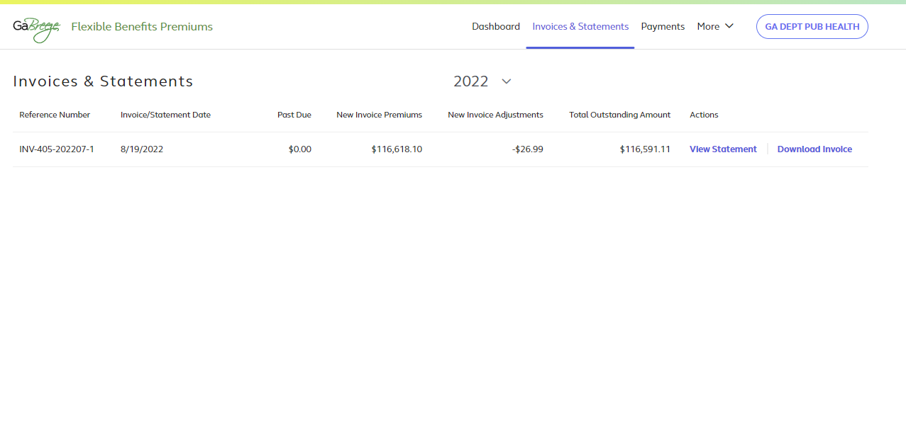
Invoices & Statements
After selecting Invoices & Statements
from the top navigation, view the current statements and download invoices as shown on this screenshot.
Invoices can be downloaded from the Dashboard and the Invoices & Statements selections.
Notes:
Now we’ll discuss invoices and statements.
The Invoices & Statements link at the top of the dashboard takes you to a page where you can view current statements and download invoices.
Your entity receives both an invoice and statement.

Slide 40
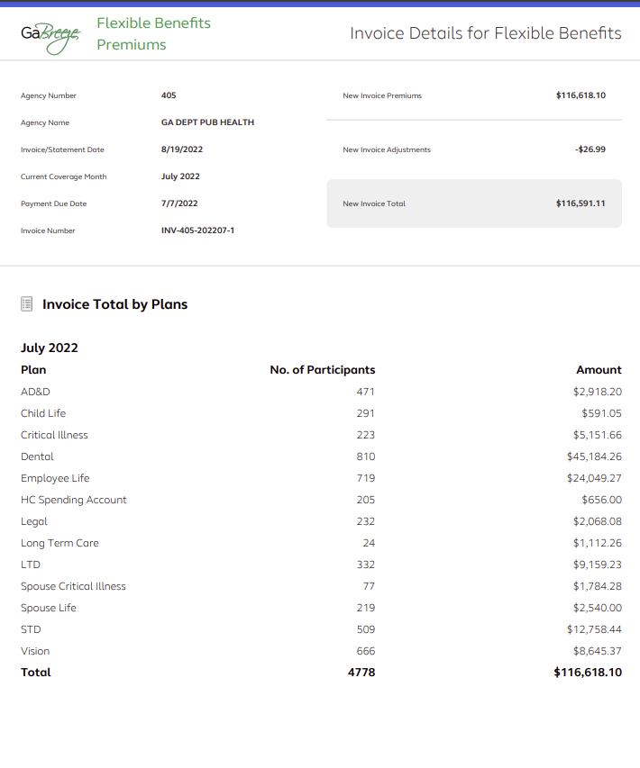
Invoices & Statements: Downloaded Invoice
Invoice
Notes:
The invoice can be downloaded from the site as a PDF and shared within your entity for financial approval and routing.
Your invoice includes new premiums and new adjustments that have been calculated in the current billing cycle.

Slide 41
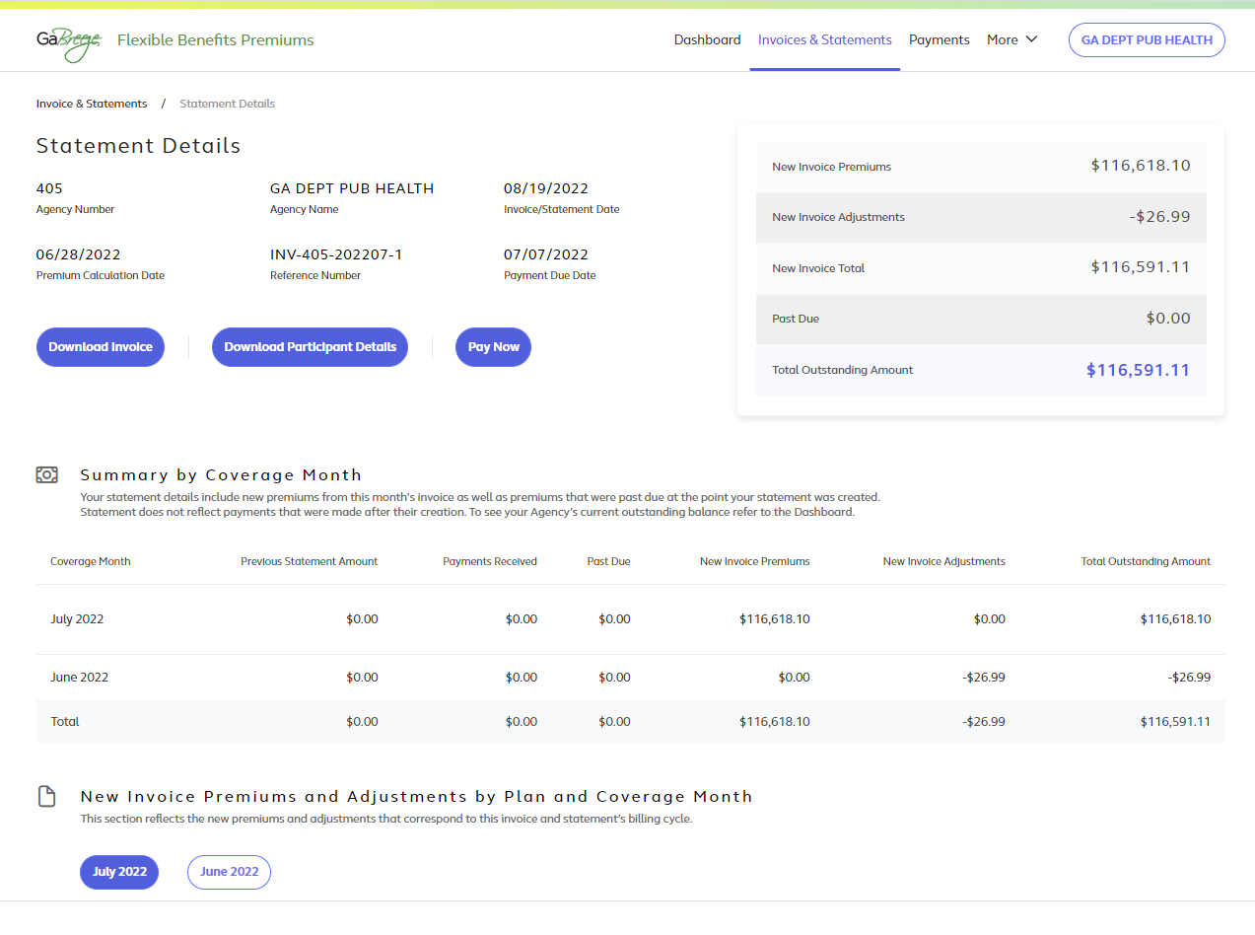
Invoices & Statements: Downloaded Statement
Statement
Notes:
Your monthly statement can be viewed online and shows the same details of new premiums and new adjustments included in your invoice.
In addition, your statement shows payments received since your last invoice/statement.
It also shows any remaining past due balances if any previous invoices were not paid in full when the statement was created.

Slide 42
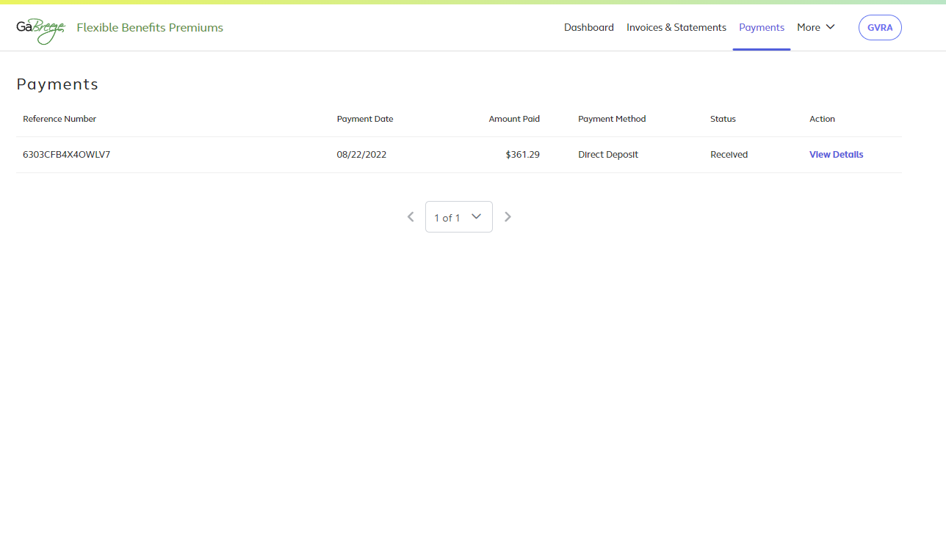
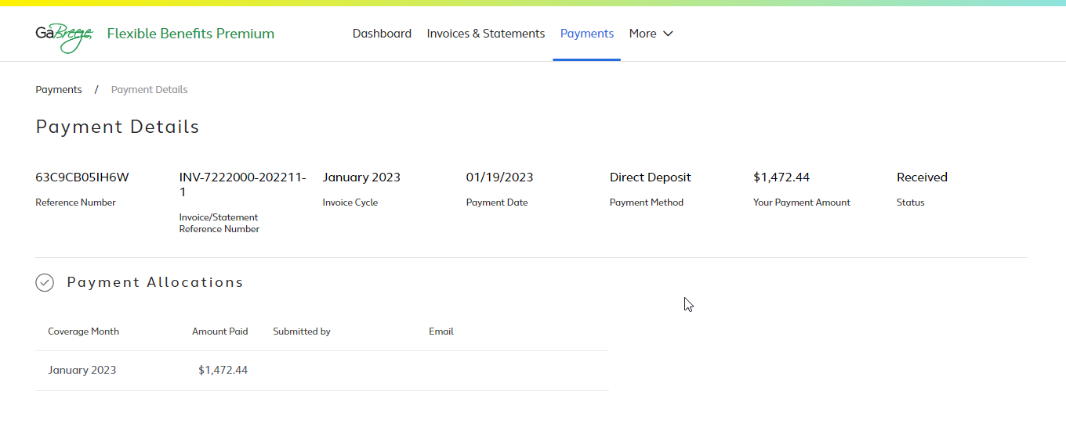
Payments
In Payment Details, view the payment date, amount paid, payment method, and status.
Notes:
The next link in the top navigation takes you to the Payments page, where you can view the payment date, amount paid, payment method and status.
From the Payments page, you can select the View Details link to reach the Payment Details page.
Once you reach the Payment Details page, you can view the payment date, amount paid, payment method and status.

Slide 43
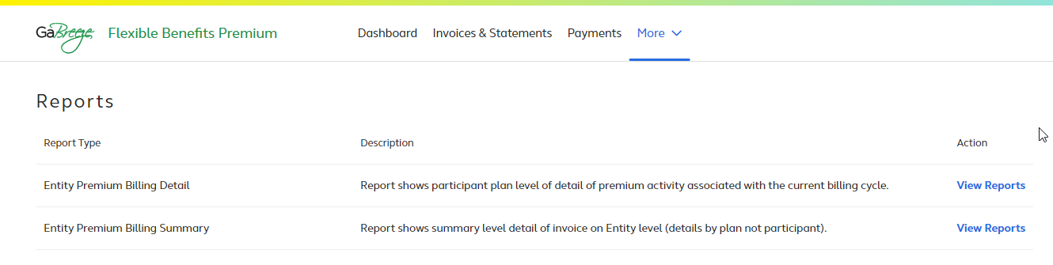
Reports
Select More and then Reports to view:
Entity Premium Billing Detail
Entity Premium Billing Summary.
Note: A new Reconciliation Report will be available this summer if payroll deduction data is provided to Alight.
Notes:
Select More and then Reports to view a page that lists all available reports, including:
Entity premium billing detail
Entity premium billing summary
You will see a short description of each report as well as a link to the actual report.

Slide 44
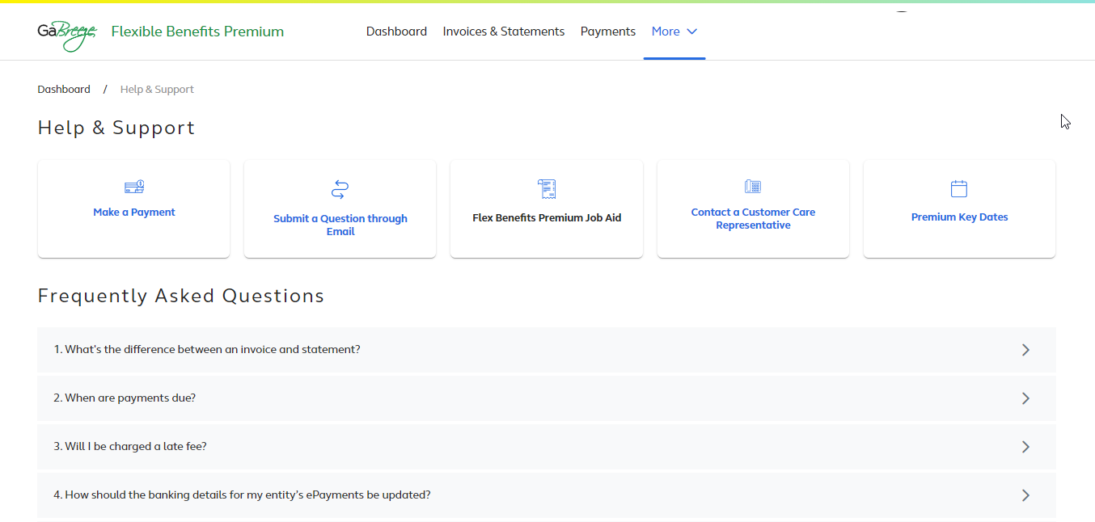
Help and Support
Select More and then Help & Support to:
Get help with questions and support
Review list of frequently asked questions
And more!
Notes:
Select More and then Help & Support to:
Get help with questions and support
Review of list of frequently asked questions, or FAQs
And more!

Slide 45
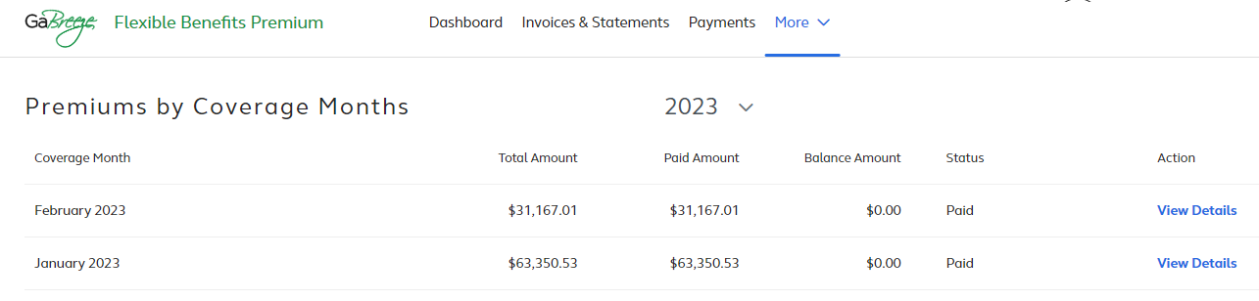
Premiums by Coverage Months
Select Premiums by Coverage Months from the More drop down to view this summary.
Choose View Details to review payment details for each month.
Notes:
The More menu contains a link to the Premiums by Coverage Months summary page.
After you review the information on this screen, select View Details to proceed.

Slide 46
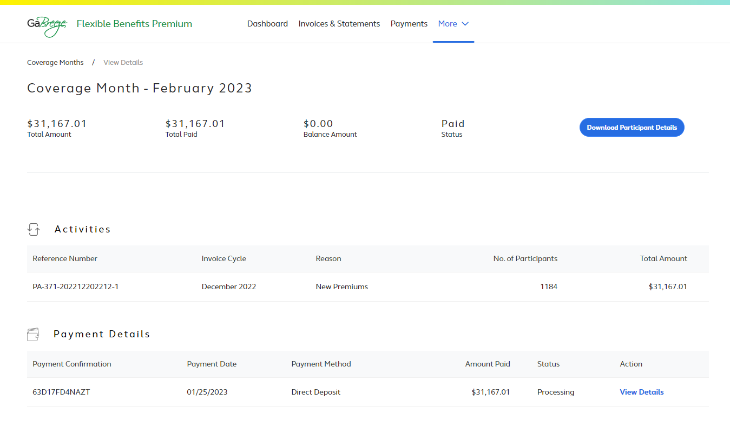
Coverage Months—View Details
The Coverage Month screen shows:
Payment details
Number of participants
Method of payment
Use the blue button to Download Participant Details.
Notes:
In addition to providing payment details, the View Details page also shows the number of participants and method of payment.
You can also download participant details from this page.

Slide 47
Partial Payments
Past due scenarios:
Eligibility timing differences
Employer eligibility errors
Enrollment timing differences or errors
Entity’s inability to remit the appropriate deductions
Participant data updates required for the first three situations listed above:
Automated and hybrid entities work with their HR/Payroll system
Manual entities must use the Employer Website tool: http://digital.alight.com/gabreezeemployer/
Question to discuss:
How will your current processes need to change when the new tool is available? Who will be involved with these changes?
Notes:
Entities are expected to pay the amounts invoiced. Those who do not pay as expected will be considered past due.
However, the financial payment tool will allow entities to pay amounts less than what's invoiced; however, if you pay less than the amount invoiced, the below scenarios will still be treated as delinquent/past due:
Eligibility timing differences – eligibility changed after an invoices' premiums were calculated vs. when payments are submitted.
Employer eligibility errors – eligibility updates that were not sent to Alight as expected.
Enrollment timing differences or errors – enrollment processed after an 'invoices' premiums were calculated vs. when payments are submitted or participants who missed enrollments or enrolled in an unintended option.
The entity’s inability to remit the appropriate deductions from payroll to cover employees' premiums.
For the first three situations, entities are expected to submit participant data updates.
Automated and hybrid entities should work with their HR/Payroll teams to make any necessary updates.
Manual entities must use the Employer Website tool to update participant details. This tool is available at http://digital.alight.com/gabreezeemployer/
Facilitator:
Allow time for entities to discuss how their current processes will need to change and who will be involved with the changes and what those changes will be. For example: Who will compare the payroll deduction reports to the benefit premium reports? Who will confirm the payments in the tool? Who will ensure the payment is confirmed in the tool prior to the payment being paid to Alight? When will the payroll and benefit reports be compared?

Slide 48
Live Demonstration
Notes:
Now that we’ve given you an overview of the key features of the tool, let’s take a look at the tool itself.
We’ll walk you through the recommended review and payment process.

Slide 49
Implementation Plan
Notes:
As we wrap up the prepared training program, we want to touch on the project timeline and highlight available resources and support.

Slide 50
Implementation Timeline
Phase 1
Phase 2a
Phase 2b
Phase 3
Final
Initial rollout and Early Adopter testing
All-entity rollout begins
Announcement
Training
Job Aid
DOAS Fiscal begins managing payments for Team Works entities
Reconciliation is live and TeamWorks entities are using the tool
Select manual entities to determine desired rollout date
Survey used to determine reconciliation needs
All entities using the new tool
Sep 2022 – Jan 2023
Feb 2023
May 2023
July 2023
Sep 2023
Notes:
[Review implementation timeline.]

Slide 51
Processing Deadlines:
January through May 2023
 | January | February | March | April | May
Invoice and Statement Ready for Your Review | January 13 | February 15 | March 15 | April 14 | May 16
Payment Confirmation Due Date | January 20 | February 20 | March 20 | April 19 | May 19
Payment Due Date | January 23 | February 22 | March 22 | April 21 | May 23
Notes:
Here are the processing deadlines for the next few months.
[Presenter should review timeline.]

Slide 52
Support Tools
Topic | Where to go
Frequently asked questions section of the payment tool | GaBreeze.ga.gov > More > Help & Support
Comments and feedback about the tool | HRA Mailbox
Questions not found in the FAQ document Problems accessing the tool or other defects Questions about premiums amounts due Questions about available reports | Alight Flexible Benefits Premium Service Center at 1-844-967-5533
Notes:
Use these resources if you need help, have questions or want to provide feedback.
Please note that the FAQs are embedded in the payment tool. There is not a separate document.

Slide 53
Questions and Discussion
Notes:
What questions or comments do you have for us?

Slide 54
Wrap-up and Next Steps

Slide 55
Your Role
Begin using the tool for review of invoice, reports and payments.
In general, you cannot use any other method after this point.
To resolve past due amounts owed prior to your implementation of the tool, contact DOAS at FlexibleBenefits.Recovery@doas.ga.gov.
Notes:
Your Entity is expected to start using this tool after today’s training.
In general, you cannot use any other payment methods after today.
To resolve past due amounts owed prior to your implementation of the tool, contact DOAS at FlexibleBenefits.Recovery@doas.ga.gov.

Slide 56
Next Steps
Confirm that you can access the Flexible Benefits Premium tool at www.GaBreeze.ga.gov (under the Administrative Tools section) using your user ID and password.
  Path: GaBreeze > Administrative Tools > Administrative Tools Summary > Flexible Benefits Premium > Select and Confirm Entity
View frequently asked questions about the tool and how to use it.
  Once you’re in the tool, select More, then Help & Support in the top navigation to access the FAQs.
Visit the Flexible Benefits Premium page to learn more: https://doas.ga.gov/human-resources-administration/employee-benefits-information/flexible-benefits-premium-tool
Notes:
In terms of immediate steps, please take a few minutes to confirm that you can access the Flexible Benefits Premium tool at www.GaBreeze.ga.gov (under the Administrative Tools section).
If you experience technical difficulties, please call the number shown on this slide. If you have questions about the tool or this training, contact the Flexible Benefits team at HRA.flexbenefits@doas.ga.gov.

Slide 57
Notes:
Wrap-up:
Thank you for participating in our training.

